Slide 1


Installation
Noble Xavier

Slide 2
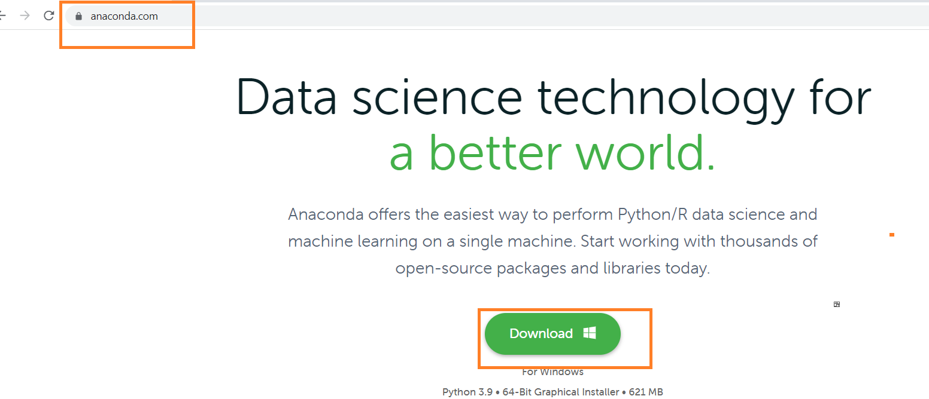
Software
https://www.anaconda.com/

Slide 3
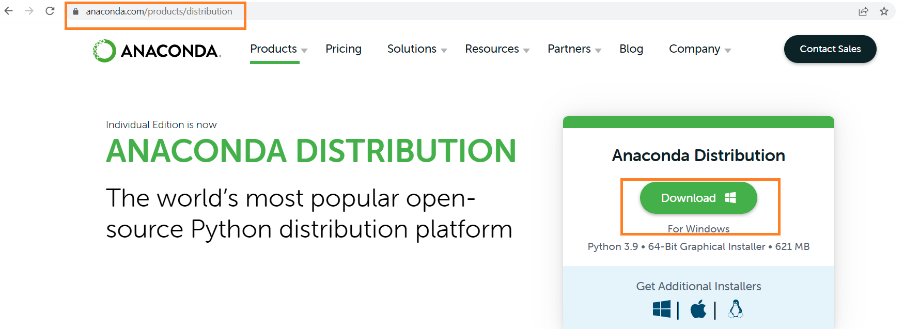
Software Download (Alternate way)
https://www.anaconda.com/products/individual

Slide 4
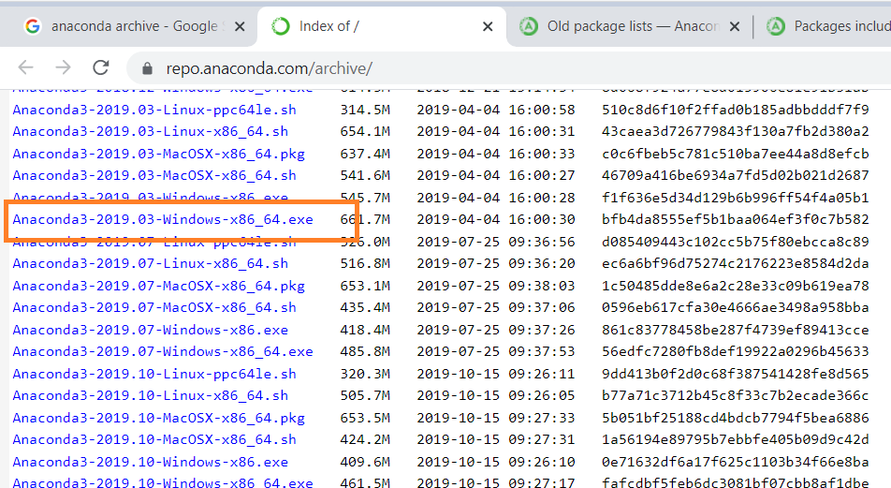
Software –Previous Versions
https://repo.anaconda.com/archive/
Installation related videos
https://www.youtube.com/watch?v=BNaHpvQhE10
https://www.youtube.com/watch?v=TNMf8rYB7eU

Slide 5
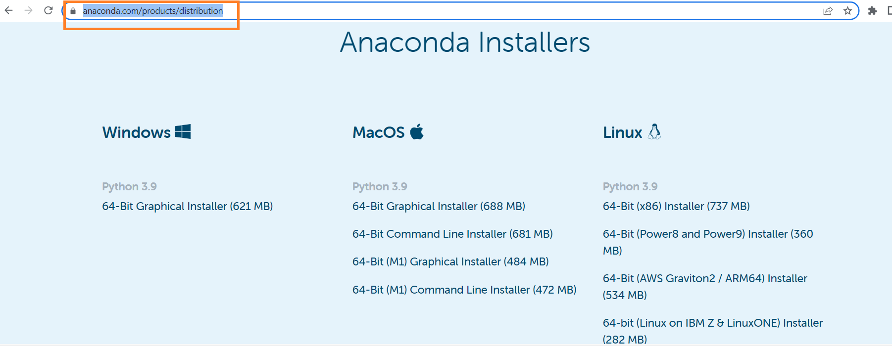
https://www.anaconda.com/products/distribution
Scroll down the page to get installers for Windows , MacOs and Linux

Slide 6
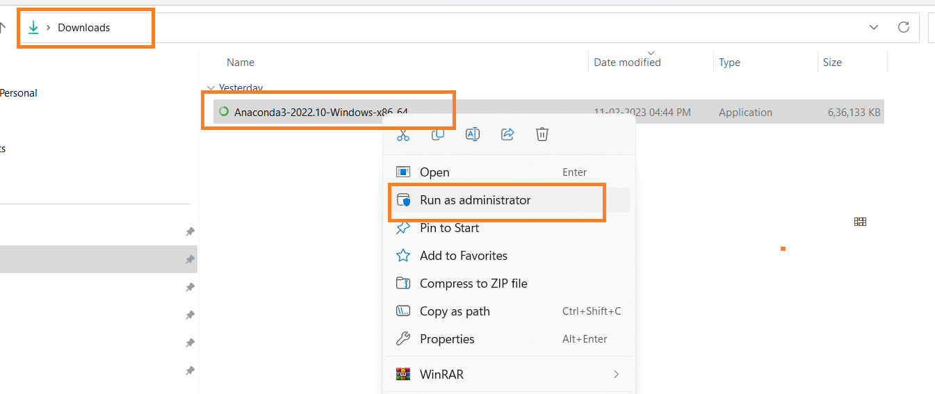
Software Installation
Download Folder -> Right Click Installer File -> Run as administrator

Slide 7
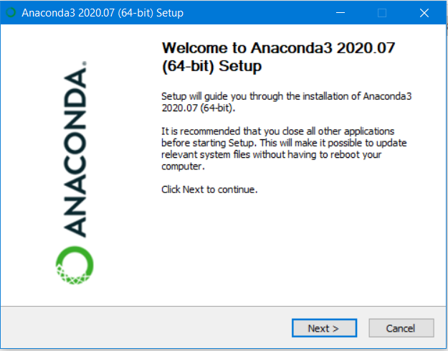
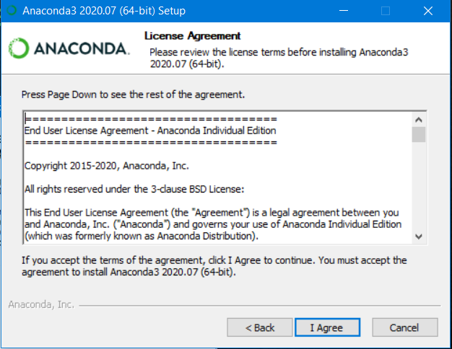
Software Installation

Slide 8
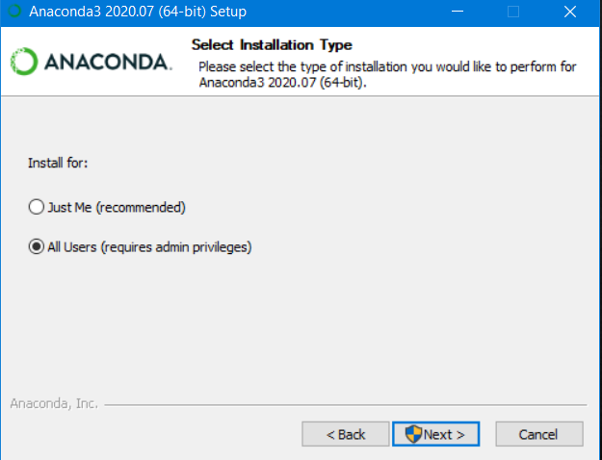
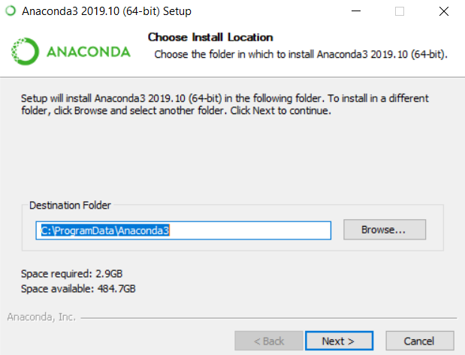
Software Installation

Slide 9
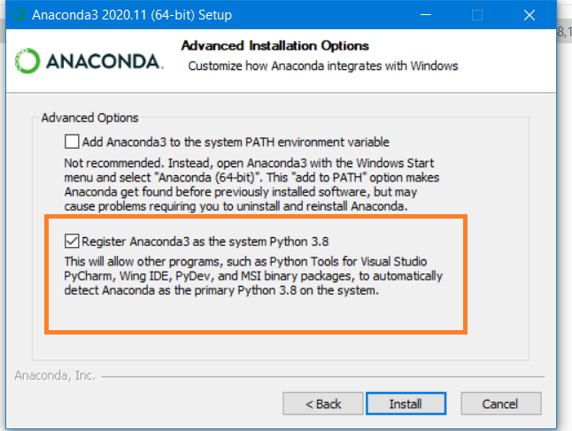
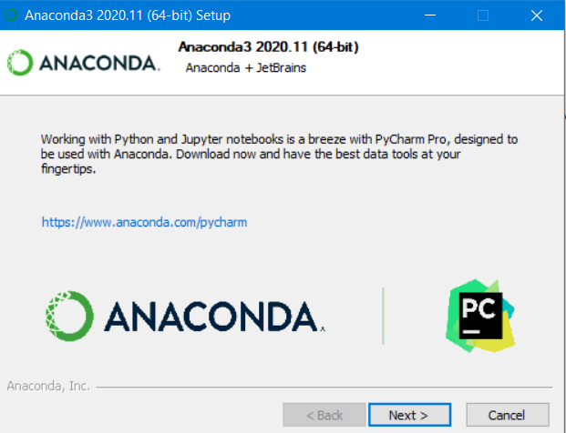
Software Installation
After complete installation

Slide 10
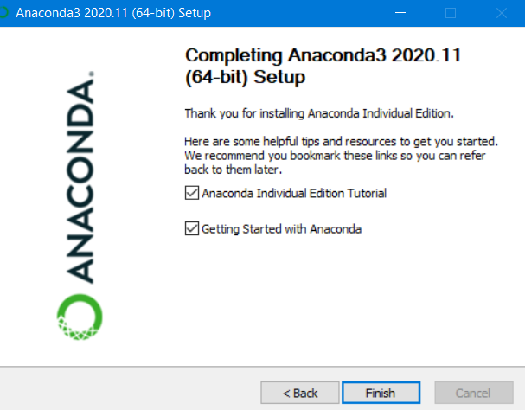
Software Installation

Slide 11
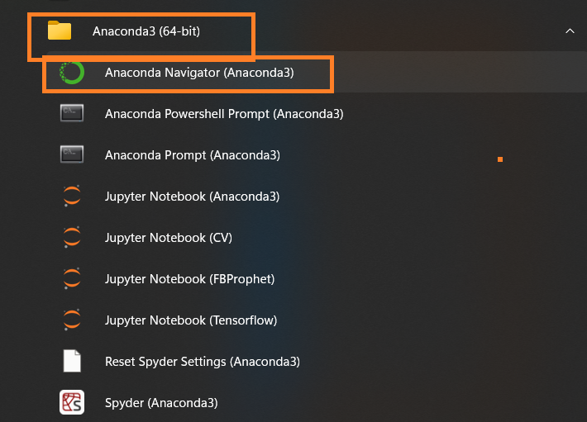
Open Anaconda Navigator
Start -> All Programs -> All Apps -> Anaconda 3 (64-bit) -> Click Anaconda Navigator (Anaconda 3)

Slide 12
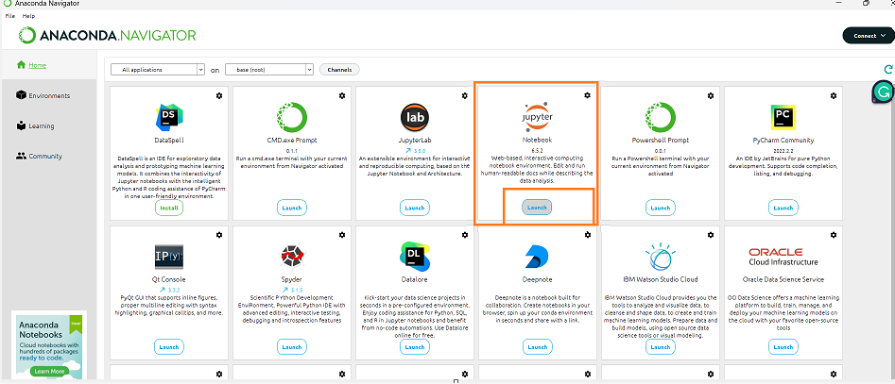
Open Jupyter Notebook
Open Anaconda Navigator -> Install / Launch Jupyter Notebook

Slide 13
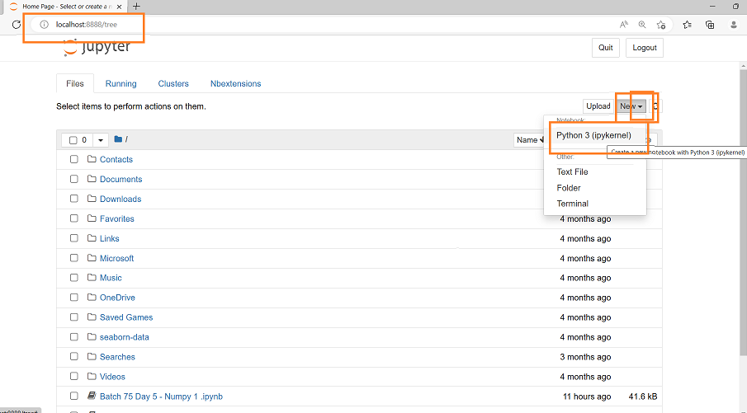
Open Jupyter Notebook
Once Kernal Opened -> New -> Python 3 (ipykernel)

Slide 14
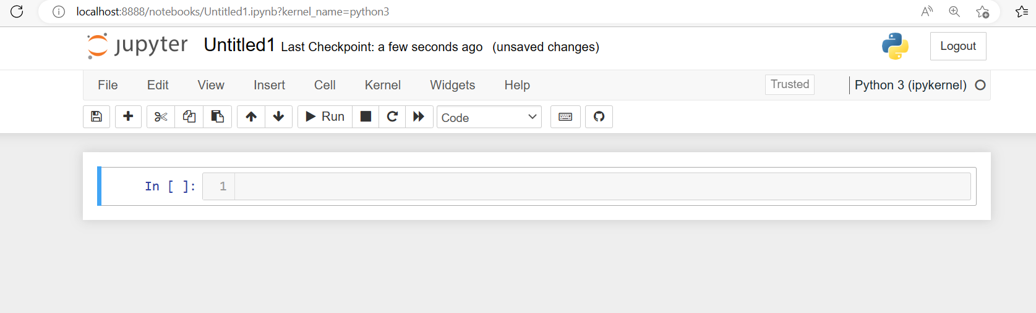
Jupyter Notebook Window

Slide 15
What is Kernal
A kernel is a runtime environment that provides programming language support for the Jupyter Notebook application.
The kernel is part of the backend responsible for executing code written by the user in the web application. For example, in the case of a Python notebook, execution of the code is typically handled by ipykernel,

Slide 16
What is Jupyter Notebook
Jupyter notebook is an open-source IDE that is used to create Jupyter documents that can be created and shared with live codes. Also, it is a web-based interactive computational environment. The Jupyter notebook can support various languages that are popular in data science such as Python, Julia, Scala, R, etc
The Jupyter system supports over 100 programming languages (called “kernels” in the Jupyter ecosystem) including Python, Java, R, Julia, Matlab, Octave, Scheme, Processing, Scala, and many more
If you are a programming and data science beginner, a Jupyter Notebook is one of the best places to start. The platform has been specifically designed for data science tasks

Slide 17
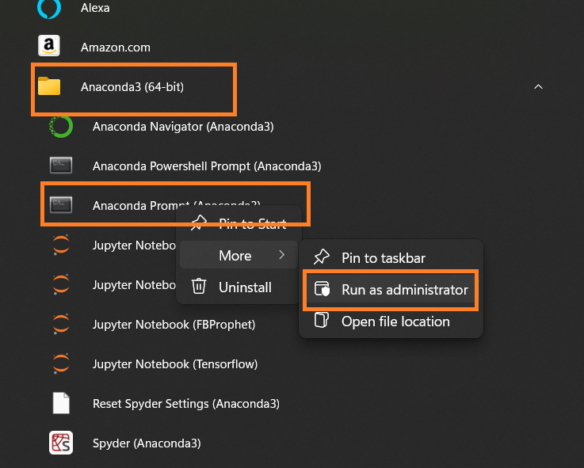
Open Jupyter Notebook from Anaconda Prompt
Open Anaconda Prompt : Start -> All Apps -> Anaconda 3 (64 bit) -> Anaconda Prompt (Anaconda 3) -> Right Click -> Run as administrator

Slide 18
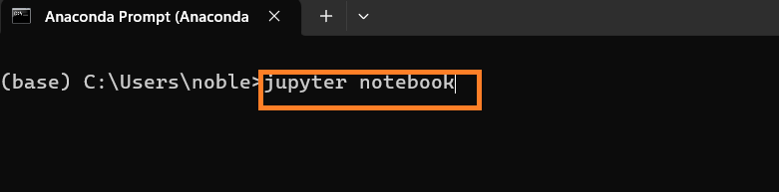
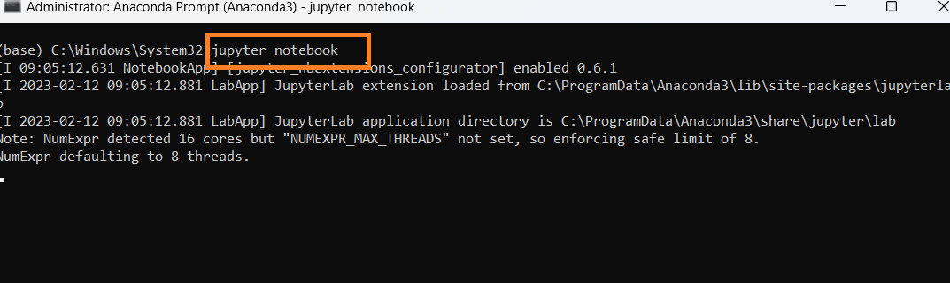
Open Jupyter Notebook from Anaconda Prompt
Type jupyter notebook and press Enter Key, it opens the Kernal in the default browser

Slide 19
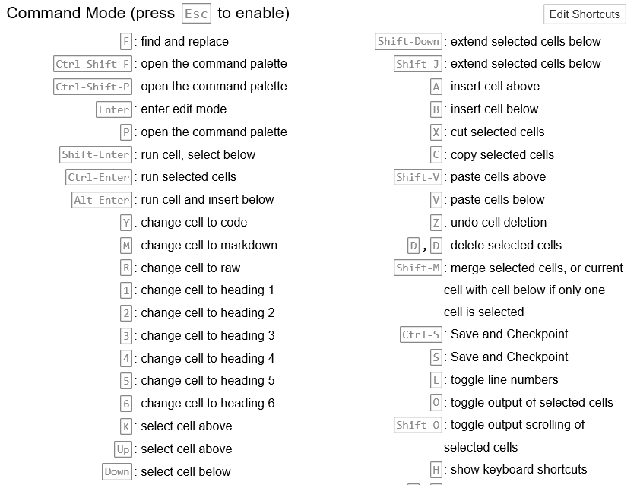
Jupyter Notebook Short cuts (Command Mode)

Slide 20
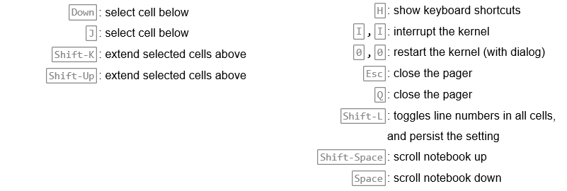
Jupyter Notebook Short cuts (Command Mode)

Slide 21
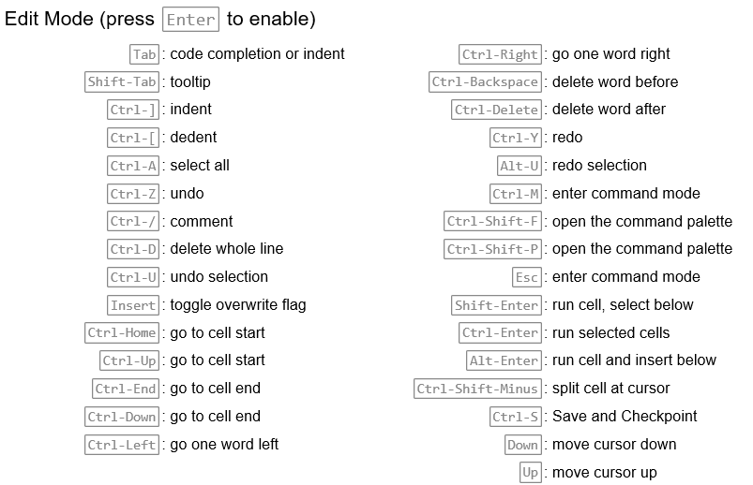
Jupyter Notebook Short cuts (Edit Mode)

Slide 22
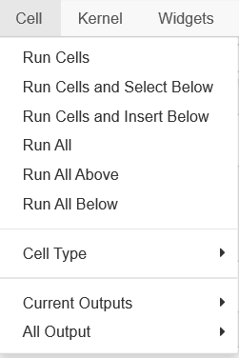
Cell Operations

